Slide 1


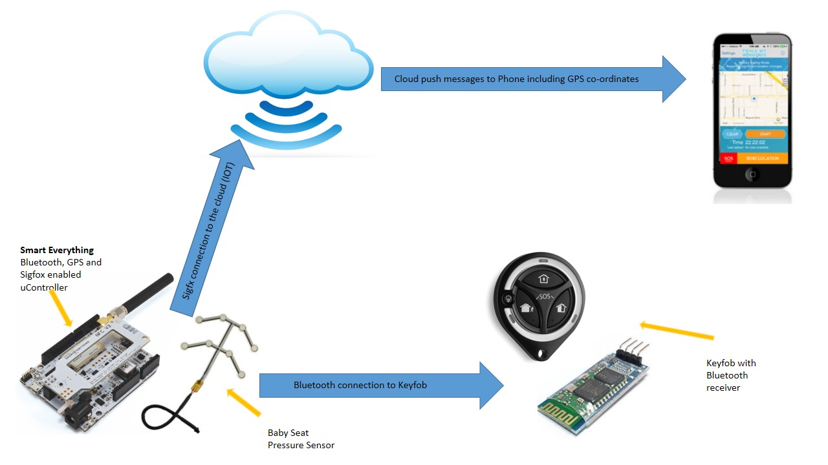
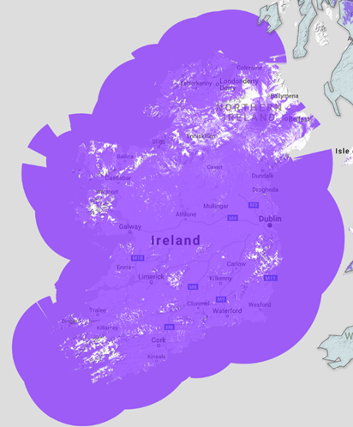

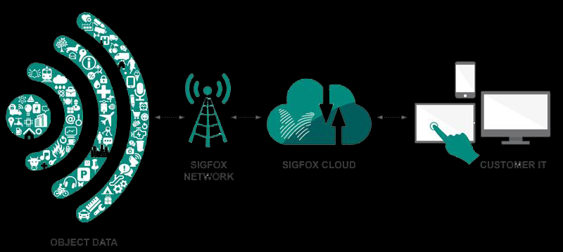
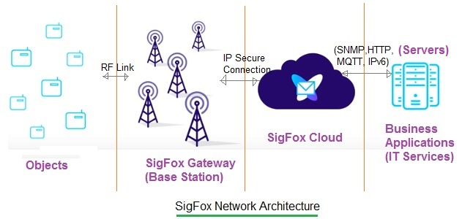


Baby on Board A device that prevents hot car deaths from occurring.

Slide 2


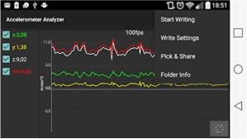
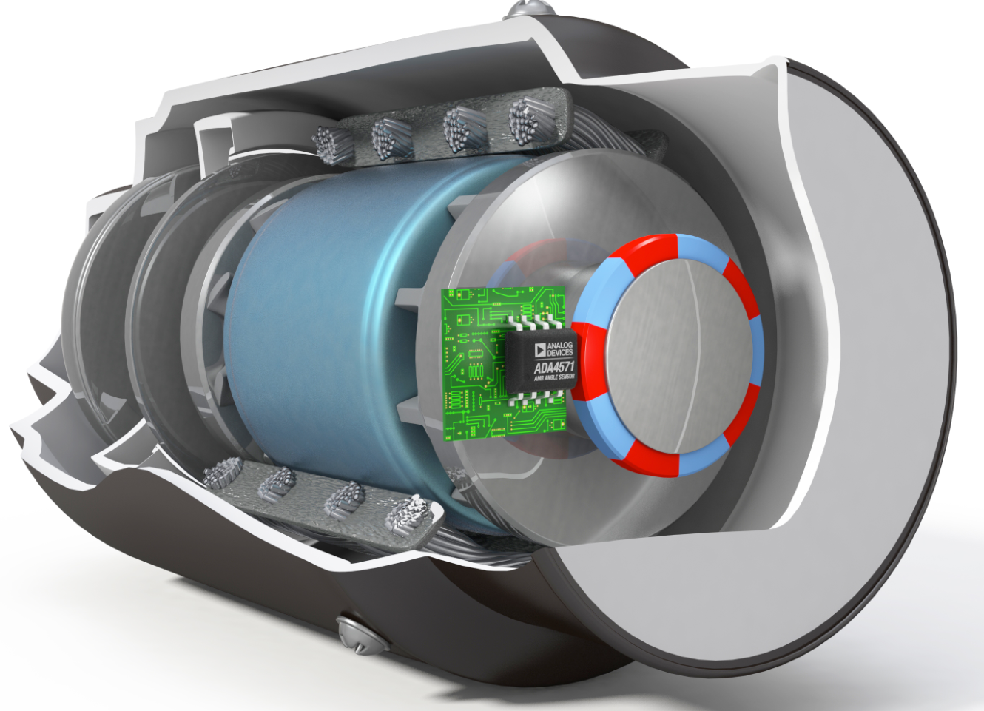
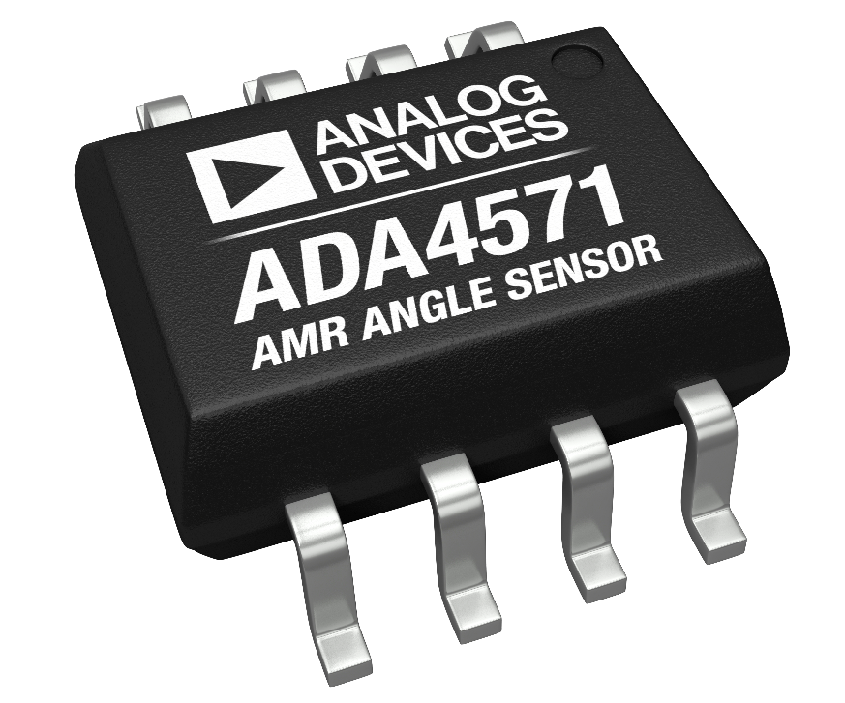




ADI Smart Pump Part of Smart Flooding Defence System
Smart Pump
Vibration
ADXL345
ADXL346
One Company alone sells 16M pumps worldwide
Pressure
AD7748
AD7180
Temperature
AD8495
TMP37
Partner with Customers
Grundfos: 16M pumps sold worldwide per year. ADI sensing technology can be added to all of these.
Retrofit: Pump sensors can also be added as a retrofit option.
Go Beyond Silicon
ADI IOT Smart Hub
Smart interface to the Cloud using ADI Smart Hub.
ADI Secure Network Secure ADI network with built in redundancy.
Innovate with Impact
Real and Immediate Need Technology solves a current problem.
Scalable Technology
Smart, secure and redundant network of sensors that can solve many other problems.

Slide 3
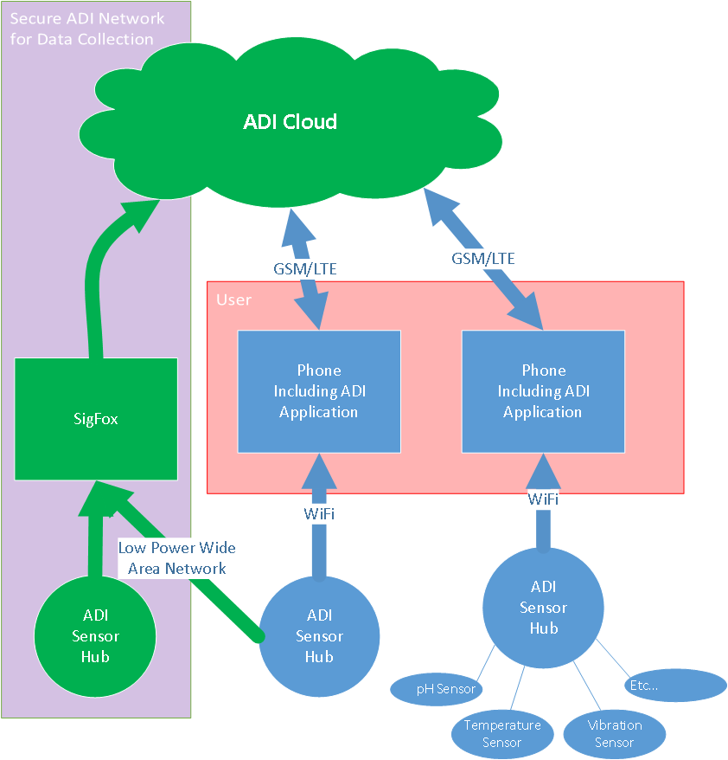
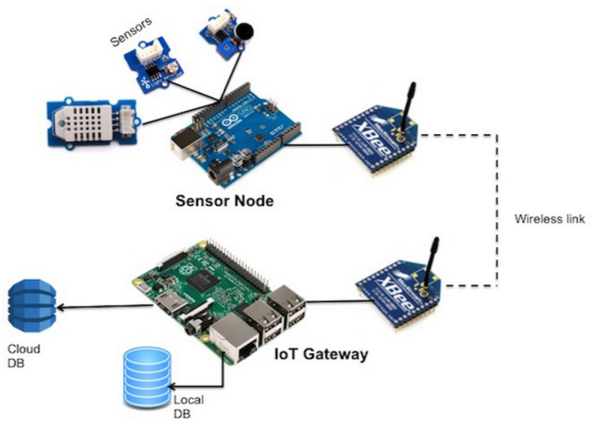
ADI Smart Hub IOT Sensors connected to the Cloud
SIGFOX Network
ADI Implementation of SIGFOX
ADF7030
ADuCM3029
ADI
Secure
Network
ADI
Smart IOT Hub

